Slide 1

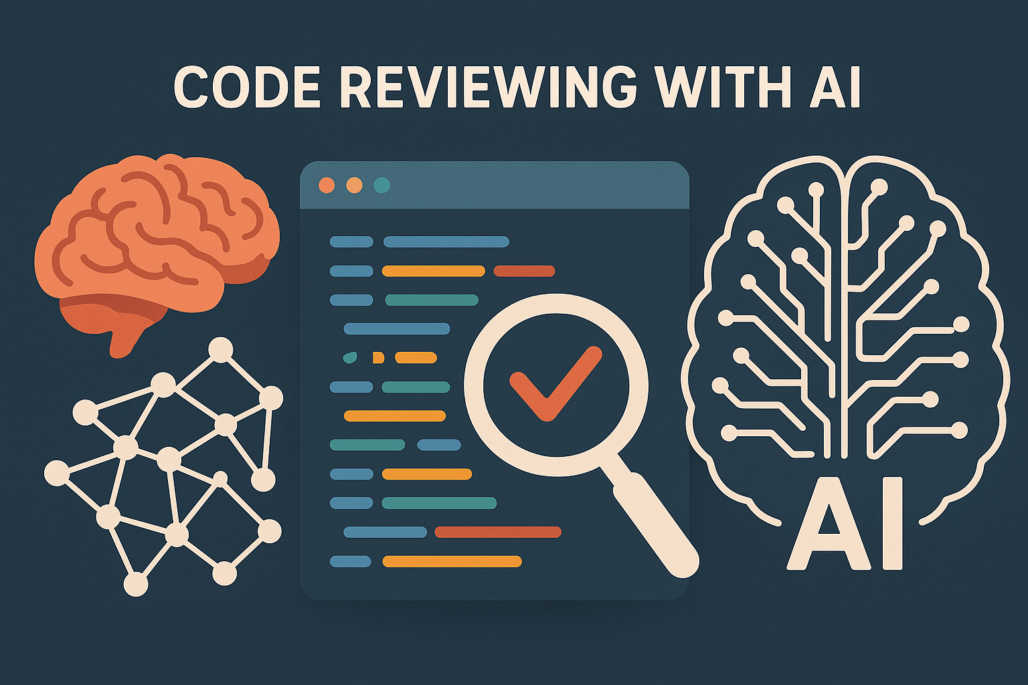
School of Computer Science and Artificial Intelligence, SR University
Course Code | Course Title | L | R | P | Cr
25CAI004PC206 | AI Assisted Coding | 0 | 0 | 4 | 2
Program Core
LAB 10 – Code Review and Quality: Using AI to improve code quality and readability
Lesson
Module 1: Code Review Fundamentals
Module 2: AI-Powered Code Review Tools Module 3: Code Quality Metrices and Assessments Module 4: Security & Vulnerability Detection in Code Using AI Module 5: Module 5: Industry Applications and Future Trends
Dr. Swarup Ghosh
Assistant Professor

Slide 2
Slide Title
Module 1: Code Review Fundamentals
1.1. Code Review Definition
1.1.1. Systematic Collaboration: A structured process where developers examine source code together to:
Identify defects (bugs, logic errors)
Improve quality (readability, performance, maintainability)
Share knowledge (patterns, domain insights, team standards)
Core Purpose: Catch issues early and elevate collective code craftsmanship beyond individual contributions.
1.1.2. Primary Benefits (Ranked by Impact & Evidence):
Bug Detection: Catches 60-90% of defects (Capers-Jones data) — most cost-effective bug prevention.
Knowledge Diffusion: Breaks silos — ensures multiple minds understand critical systems.
Quality Assurance: Enforces standards (SOLID, DRY) + prevents "technical debt avalanches."
Security Hardening: Finds vulnerabilities before exploitation.
Key Insight: 1 hour of review saves 33 hours of debugging (IBM Systems Sciences Institute).

Slide 3
Slide Title
Module 1: Code Review Fundamentals
1.1.3. Traditional Methods (Pre-AI Era Techniques):
Method | How It Works | Best For | Limitations
Manual Inspection | Formal meeting; reviewer studies code offline + documents feedback | Critical systems (safety/mission-critical) | Slow; prone to human fatigue
Pair Programming | Two developers: Driver (codes) + Navigator (reviews in real-time) | Complex logic; rapid upskilling | Resource-intensive (2x effort)
Over-the-Shoulder | Quick ad-hoc review; reviewer observes as author walks through code | Small fixes; junior mentorship | Informal; misses deeper issues
Tool-Assisted | Uses linters (ESLint), static analyzers (SonarQube), or CI checks | Enforcing style guides; basic smells | Limited to automatable rules

Slide 4
Slide Title
Module 1: Code Review Fundamentals
1.1.4. Lab-Ready Impact:
Benefit | Lab Exercise | Tool Example
Bug Detection | Inject 10 bugs into a code sample. Students find ≥7 using review. | Pytest (verify fixes)
Knowledge Sharing | Review a classmate’s algorithm; document 1 new trick you learned. | GitHub PR comments
Quality Assurance | Apply PEP-8/Google style guide to messy code. | Flake8 (auto-check)
Security | Find Python's pickle module vulnerability in a Flask app. | Bandit (Python SAST)
Lab Stat: Teams that review code reduce production bugs by 70% (Microsoft Case Study).

Slide 5
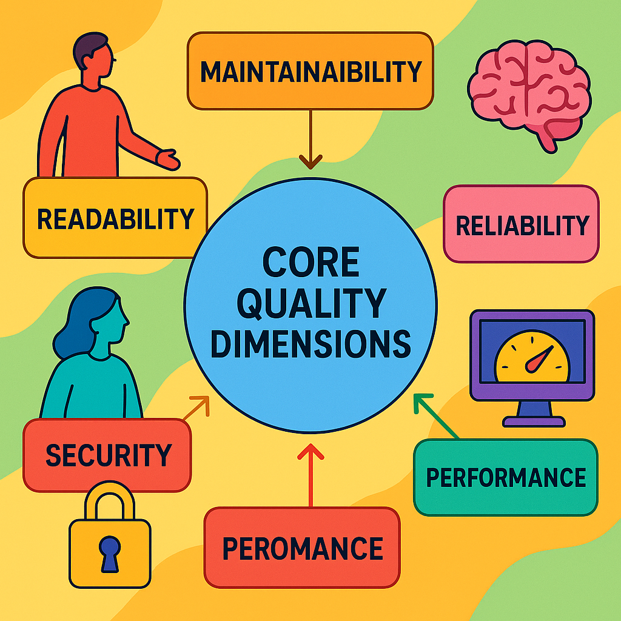
Slide Title
Module 1: Code Review Fundamentals
1.1.5. Core Quality Dimensions
Maintainability - Ease of modification and extension
Reliability - Consistent performance across conditions
Readability - Code clarity and understandability
Performance - Efficient resource utilization
Security - Vulnerability resistance

Slide 6
Slide Title
Module 2: AI-Powered Code Review Tools
2.1. AI Capabilities in Code Review
AI transforms code review by automating tedious tasks and enhancing code quality.
Four key capabilities are:
Pattern Recognition What it does: Identifies recurring code smells (e.g., duplicated code, unused variables) by analyzing historical data.
Example: Detecting for – loop anti-patterns (like off-by-one errors) across a codebase.
Python Snippet:
# AI flags duplicated code using hashing
import hashlib
def hash_code(code):
return hashlib.sha256(code.encode()).hexdigest()

Slide 7
Slide Title
Module 2: AI-Powered Code Review Tools
Predictive Analysis What it does: Predicts bugs or vulnerabilities before deployment (e.g., Python's pickle module). Example: Estimating defect probability in new commits based on past failures.
Automated Suggestions What it does: Recommends fixes (e.g., "Use list comprehension here” ) or optimizations in real-time. Example: Converting loops to vectorized operations in data-heavy code.
Adaptive Learning What it does: Learns from developer feedback to improve future suggestions (e.g., custom style rules). Example: Prioritizing security fixes if the team frequently ignores T0D0 comments.

Slide 8
Slide Title
Module 2: AI-Powered Code Review Tools
2.2. Leading AI Code Review Tools
Tool | Key Features | Best For
CodeAnt AI | Real-time linting, duplicate detection, cloud-native | Startups & cloud projects
SonarQube | Deep static analysis, 25+ language support, technical debt reports | Enterprise legacy systems
GitHub Copilot | AI pair programmer, code generation, natural language prompts | Rapid prototyping & learning
Snyk Code | Security-focused, finds vulnerabilities in IDE/CI, dependency scanning | DevSecOps pipelines
CodeRabbit | PR summaries, line-by-line reviews, chat-based feedback | Teams using GitHub/GitLab

Slide 9
Slide Title
Module 2: AI-Powered Code Review Tools
2.2. Leading AI Code Review Tools
Tool | Type | Key Strengths | Language Support | License/Price
SonarQube | Open-Source | Deep static analysis, technical debt reports, OWASP security compliance | 30+ languages (Java, C#, JS) | Free Community Edition; Paid plans from $20/user/month
GitHub Copilot | Proprietary | AI pair programming, real-time suggestions, PR summaries | 10+ (Python, JS, TS) | $10–$39/user/month
Snyk Code (DeepCode) | Proprietary | Security-focused SAST, real-time vulnerability scanning | 11+ (Python, Java, JS) | Free for OSS; Teams from $25/user/month
ESLint | Open-Source | Configurable JavaScript linting, AI plugins for adaptive rules | JavaScript/TypeScript | Free (MIT)
CodeRabbit | Proprietary | PR summaries, line-by-line feedback, chat-based reviews | 15+ (Python, JS, Go) | Free tier; Pro $24/user/month
Infer | Open-Source | Formal verification for null pointers, memory leaks; CI/CD integration | C/C++, Java, Objective-C | Free (MIT)
CodeQL | Open-Source | Semantic analysis for zero-day vulnerabilities; treats code as data | 10+ (C++, Python, JS) | Free (Apache 2.0)

Slide 10
Slide Title
Module 2: AI-Powered Code Review Tools
2.3. Tool Selection Criteria
Choose tools based on these pillars:
Integration Capabilities Why: Must fit into existing workflows (CI/CD, Git, IDEs). Check: Does it support GitHub Actions/Jenkins? Slack alerts?
Language Support Why: Polyglot projects need broad coverage (e.g., Python + JavaScript + Rust). Check: Verify support for legacy (Cobol) vs. modern (Kotlin) languages.
Customization Options Why: Adapt rules to team standards (e.g., ignore PEP8 line length).
Security Features Why: Prevent OWASP Top 10 risks (XSS, broken auth). Check: Does it scan secrets (API keys) or dependencies (Log4j)?

Slide 11
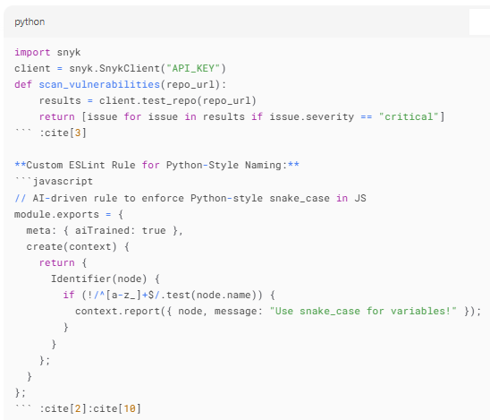
Slide Title
Module 2: AI-Powered Code Review Tools
Assignment 2: Python Integration Examples
Automated Security Scan with Snyk API:

Slide 12
Slide Title
Module 3: Code Quality Metrices and Assessments
3.1. Quantitative Metrics
Objective measurements for empirical quality control:
Metric | Ideal Target | What It Measures | Python Example
Cyclomatic Complexity | 1-10 | Logical branches/paths (higher = riskier code) | radon cc module.py (Radon tool output)
Code Coverage | 70-90% | % of code exercised by tests | pytest --cov=app (Coverage.py report)
Technical Debt | <5% effort | Hours needed to fix accumulated shortcuts | SonarQube's "Sqale Index" metric

Slide 13
Slide Title
Module 3: Code Quality Metrices and Assessments
Python Snippet - Complexity Calculation:
# Manual cyclomatic complexity estimate
def calculate_complexity(func_code):
complexity = 1 # Start with 1 path
keywords = ['if', 'for', 'while', 'and', 'or', 'except']
for keyword in keywords:
complexity += func_code.count(f" {keyword} ")
return complexity
# Example: complexity=3 (1 base + 1 'if' + 1 'for')
code = """
def process_data(data):
if data: # +1
for item in data: # +1
print(item)
"""
print(calculate_complexity(code)) # Output: 3

Slide 14
Slide Title
Module 3: Code Quality Metrices and Assessments
3.2. Qualitative Factors
Subjective but critical for maintainability:
Naming Conventions (Python Snippet)
# Bad
a = fetch_data() # Non-descriptive
# Good
user_orders = get_orders() # Clear intent
Code Structure
Modular files (<200 LOC)
DRY (Don't Repeat Yourself) compliance
Low inter-module coupling

Slide 15
Slide Title
Module 3: Code Quality Metrices and Assessments
Documentation Quality
def calculate_interest(principal, rate, time):
"""
Computes compound interest.
Args:
principal: Initial investment (float)
rate: Annual interest rate (0.05 = 5%)
time: Years (int)
Returns:
Final amount (float)
"""
return principal * (1 + rate) ** time

Slide 16
Slide Title
Module 3: Code Quality Metrices and Assessments
3.3. Measurement Tools
Automated assessment frameworks:
Tool | Primary Strength | Metrics Covered
SonarQube | Technical debt analysis + security | Complexity, coverage, debt, duplication
CodeClimate | Maintainability grade (A-F) | Churn, structure, test coverage
PMD | Custom rules for Java/JS | Complexity, naming, best practices

Slide 17
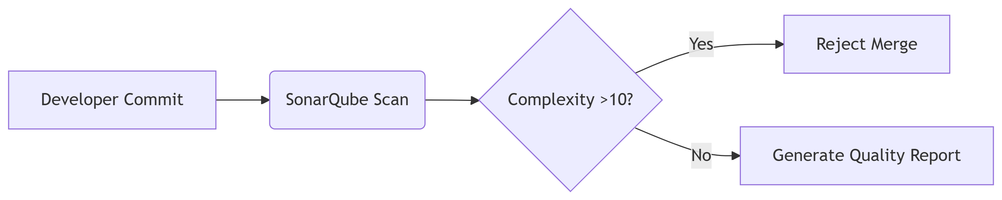
Slide Title
Module 3: Code Quality Metrices and Assessments
Workflow Integration:

Slide 18
Slide Title
Module 3: Code Quality Metrices and Assessments
3.4.3. Code Churn
What it reveals:
High churn = unstable code (design flaws/requirement volatility)
Low churn = mature code
Git command (bash):
3.4. Critical Metrics Deep Dive
3.4.1. Cyclomatic Complexity
Why it matters: Predicts testing difficulty & defect risk
Risk levels:
1-10: Safe (green)
11-20: Moderate (yellow)
20+: High risk (red)
Reduction tactic: Refactor nested conditionals
3.4.2 Code Coverage
Measurement (bash):
git log --since="1 month" -p app.py # Track file changes
3.4.4. Technical Debt
Calculation (Python):
tech_debt_ratio = (remediation_hours / total_dev_hours) * 100
# Run tests with coverage
pytest --cov=my_app --cov-report=html
Management:
Dedicate 1 sprint/quarter to debt reduction
Prioritize high-risk files (SonarQube hotspots)

Slide 19
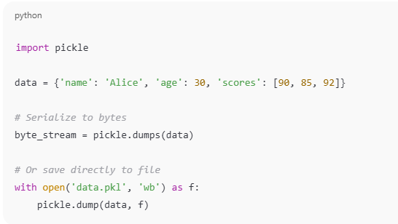
Slide Title
Module 4: Security & Vulnerability Detection in Code Using AI
4.1. Common Vulnerabilities
Critical flaws AI tools detect:
Vulnerability | Description | Python Example
Python's pickle module | Converting Python objects to a byte stream (for storage or transmission) and restoring them back later | import pickle

Slide 20
Slide Title
Module 4: Security & Vulnerability Detection in Code Using AI
4.2. AI Security Tools
Automated vulnerability detection (for known purpose only):
Tool | Strengths | Vulnerabilities Covered
Snyk Code | Real-time SAST, IDE integration | Pickleing, XSS, hardcoded secrets
Semgrep | Custom rules, 20+ languages, CI/CD friendly | Auth flaws, config errors
CodeQL | Semantic analysis, "code as data" approach | 0-days, complex logic flaws

Slide 21
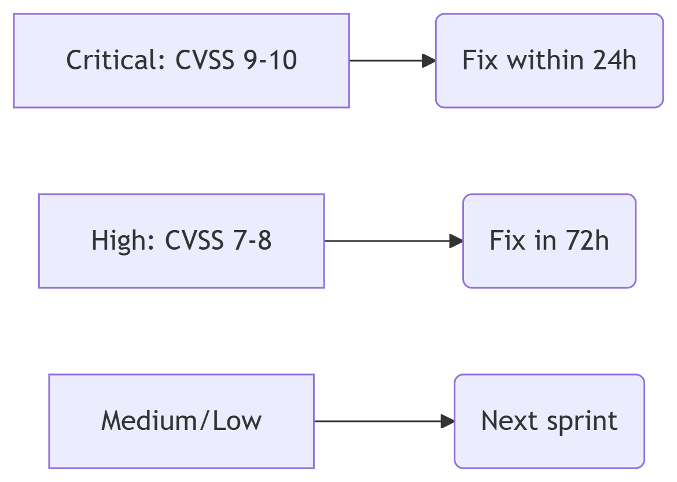
Slide Title
Module 4: Security & Vulnerability Detection in Code Using AI
4.3. Security Review Process
Three-step AI-powered workflow:
4.3.1. Automated Scanning
Tools: Snyk/CodeQL in CI pipeline
Command: semgrep --config=p/security-audit
Output: Vulnerability report (CVE IDs, severity)
4.3.2. Manual Verification
Validate true positives (e.g., exploit POC)
Check false positives (AI may flag safe code)
4.3.2. Remediation Prioritization

Slide 22
Slide Title
Module 4: Security & Vulnerability Detection in Code Using AI
4.4. Vulnerability Categories
4.4.1 Input Validation
Risks: Python's pickle module
AI Detection (Python)
Fix: Input sanitization + parameterized queries
4.4.2 Authentication/Authorization
Risks: Broken access control, weak passwords
AI Detection:
Flags role = “admin” without MFA
Detects password complexity bypass

Slide 23
Slide Title
Module 4: Security & Vulnerability Detection in Code Using AI
4.4.3 Data Exposure
Risks: Plaintext secrets, missing encryption
Tool Example (bash):*
truffleHog --regex --entropy=False code_repo/ # Find API keys
4.4.4 Configuration Errors
Risks: Default credentials, open ports
AI Detection:
Flags DEBUG=TRUE in production
Detects exposed cloud storage (S3 buckets)

Slide 24
Slide Title
Module 5: Industry Applications and Future Trends
5.1. Key Concepts
Current Adoption: 70% enterprise adoption, 25-40% productivity gains
Emerging Technologies: Large language models, agentic AI systems
Future Directions: Edge computing, quantum applications, XR interfaces
5.2. Industry Trends
AI Evolution - GPT-4 integration, specialized code models
Automation Increase - Autonomous decision-making, reduced human intervention
Security Focus - Enhanced vulnerability detection, compliance automation
Sustainability - Energy-efficient analysis, carbon footprint considerations

Slide 25
Slide Title
Module 1: Code Review Fundamentals
Assignments
Assignment 1: Manual Code Review Exercise
Review a simple code sample with intentional bugs
Submit findings with line-by-line comments
Duration: 0.5 hours

Slide 26
Slide Title
Module 2: AI-Powered Code Review Tools
Assignments
Assignment 2: AI Tool Comparison
Set up and test Two different AI code review tools
Duration: 0.5 hours

Slide 27
Slide Title
Module 4: Security & Vulnerability Detection in Code Using AI
Assignments
Assignment 3:
Write simple Python code to check Pickling (Serialization) and Unpickling (Deserialization) conditions
Duration: 0.5 hours

Slide 28
Slide Title
Module 5: Industry Applications and Future Trends
Assignments
Assignment 4: Industry Case Study Analysis
Research and analyze code review practices at one major tech company
Identify success factors and implementation challenges (Include emerging technologies and novel capabilities)
Duration: 0.5 hours

